Slide 1

Big Data Infrastructure
Session 3: MapReduce – Basic Algorithm Design
Jimmy Lin
University of Maryland
Monday, February 9, 2015
This work is licensed under a Creative Commons Attribution-Noncommercial-Share Alike 3.0 United States See http://creativecommons.org/licenses/by-nc-sa/3.0/us/ for details

Slide 2

Source: Wikipedia (The Scream)

Slide 3

Source: Wikipedia (Japanese rock garden)

Slide 4
Today’s Agenda
MapReduce algorithm design
How do you express everything in terms of m, r, c, p?
Toward “design patterns”
Real-world word counting: language models
How to break all the rules and get away with it

Slide 5

MapReduce
Source: Google

Slide 6
MapReduce: Recap
Programmers must specify:
map (k, v) → <k’, v’>*
reduce (k’, v’) → <k’, v’>*
All values with the same key are reduced together
Optionally, also:
partition (k’, number of partitions) → partition for k’
Often a simple hash of the key, e.g., hash(k’) mod n
Divides up key space for parallel reduce operations
combine (k’, v’) → <k’, v’>*
Mini-reducers that run in memory after the map phase
Used as an optimization to reduce network traffic
The execution framework handles everything else…

Slide 7
k₁
v₁
k₂
v₂
k₃
v₃
k₄
v₄
k₅
v₅
k₆
v₆
map
map
map
map
a
1
b
2
c
3
c
6
a
5
c
2
b
7
c
8
combine
combine
combine
combine
a
1
b
2
c
9
a
5
c
2
b
7
c
8
partition
partition
partition
partition
Shuffle and Sort: aggregate values by keys
a
1
5
b
2
7
c
2
9
8
reduce
reduce
reduce
r₁
s₁
r₂
s₂
r₃
s₃

Slide 8
“Everything Else”
The execution framework handles everything else…
Scheduling: assigns workers to map and reduce tasks
“Data distribution”: moves processes to data
Synchronization: gathers, sorts, and shuffles intermediate data
Errors and faults: detects worker failures and restarts
Limited control over data and execution flow
All algorithms must expressed in m, r, c, p
You don’t know:
Where mappers and reducers run
When a mapper or reducer begins or finishes
Which input a particular mapper is processing
Which intermediate key a particular reducer is processing

Slide 9
Tools for Synchronization
Cleverly-constructed data structures
Bring partial results together
Sort order of intermediate keys
Control order in which reducers process keys
Partitioner
Control which reducer processes which keys
Preserving state in mappers and reducers
Capture dependencies across multiple keys and values

Slide 10
Preserving State
Mapper object
Reducer object
one object per task
state
state
setup
API initialization hook
setup
map
one call per input key-value pair
reduce
one call per intermediate key
cleanup
API cleanup hook
close

Slide 11
Scalable Hadoop Algorithms: Themes
Avoid object creation
Inherently costly operation
Garbage collection
Avoid buffering
Limited heap size
Works for small datasets, but won’t scale!

Slide 12
Importance of Local Aggregation
Ideal scaling characteristics:
Twice the data, twice the running time
Twice the resources, half the running time
Why can’t we achieve this?
Synchronization requires communication
Communication kills performance
Thus… avoid communication!
Reduce intermediate data via local aggregation
Combiners can help

Slide 13
Shuffle and Sort
Mapper
intermediate files (on disk)
merged spills (on disk)
Combiner
Reducer
circular buffer (in memory)
Combiner
other reducers
spills (on disk)
other mappers

Slide 14
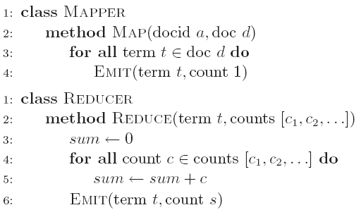
Word Count: Baseline
What’s the impact of combiners?

Slide 15
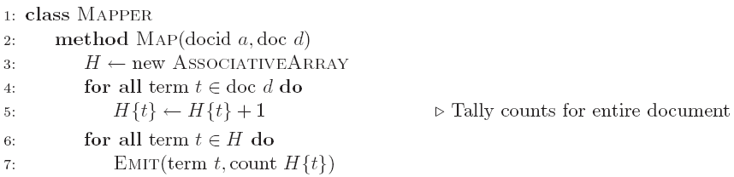
Word Count: Version 1
Are combiners still needed?

Slide 16
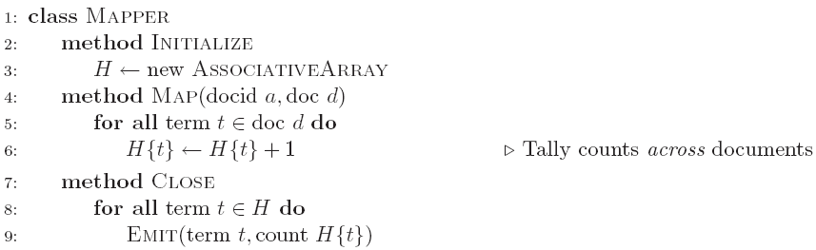
Word Count: Version 2
Key idea: preserve state across input key-value pairs!
Are combiners still needed?

Slide 17
Design Pattern for Local Aggregation
“In-mapper combining”
Fold the functionality of the combiner into the mapper by preserving state across multiple map calls
Advantages
Speed
Why is this faster than actual combiners?
Disadvantages
Explicit memory management required
Potential for order-dependent bugs

Slide 18
Combiner Design
Combiners and reducers share same method signature
Sometimes, reducers can serve as combiners
Often, not…
Remember: combiner are optional optimizations
Should not affect algorithm correctness
May be run 0, 1, or multiple times
Example: find average of integers associated with the same key

Slide 19
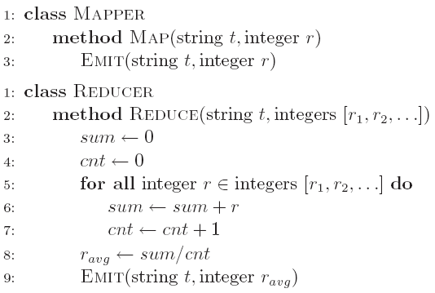
Computing the Mean: Version 1
Why can’t we use reducer as combiner?

Slide 20
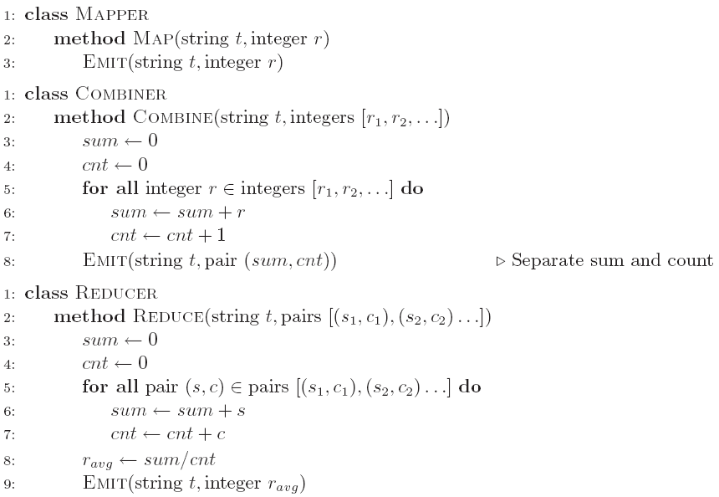
Computing the Mean: Version 2
Why doesn’t this work?

Slide 21
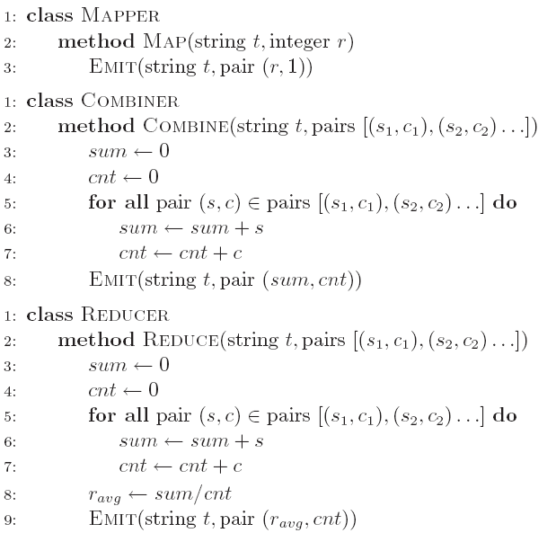
Computing the Mean: Version 3
Fixed?

Slide 22
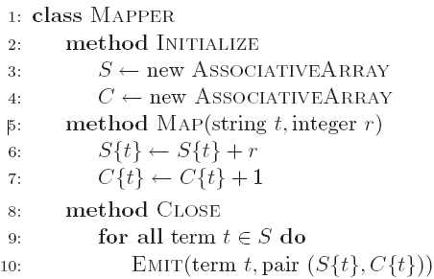
Computing the Mean: Version 4
Are combiners still needed?

Slide 23
Algorithm Design: Running Example
Term co-occurrence matrix for a text collection
M = N x N matrix (N = vocabulary size)
M_{ij}: number of times i and j co-occur in some context (for concreteness, let’s say context = sentence)
Why?
Distributional profiles as a way of measuring semantic distance
Semantic distance useful for many language processing tasks

Slide 24
MapReduce: Large Counting Problems
Term co-occurrence matrix for a text collection = specific instance of a large counting problem
A large event space (number of terms)
A large number of observations (the collection itself)
Goal: keep track of interesting statistics about the events
Basic approach
Mappers generate partial counts
Reducers aggregate partial counts
How do we aggregate partial counts efficiently?

Slide 25
First Try: “Pairs”
Each mapper takes a sentence:
Generate all co-occurring term pairs
For all pairs, emit (a, b) → count
Reducers sum up counts associated with these pairs
Use combiners!

Slide 26
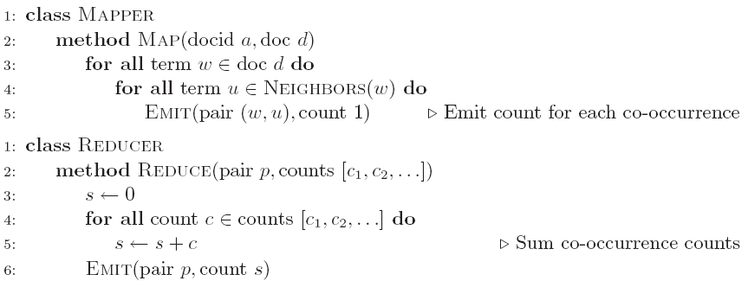
Pairs: Pseudo-Code

Slide 27
“Pairs” Analysis
Advantages
Easy to implement, easy to understand
Disadvantages
Lots of pairs to sort and shuffle around (upper bound?)
Not many opportunities for combiners to work

Slide 28
Another Try: “Stripes”
Idea: group together pairs into an associative array
Each mapper takes a sentence:
Generate all co-occurring term pairs
For each term, emit a → { b: count_{b}, c: count_{c}, d: count_{d} … }
Reducers perform element-wise sum of associative arrays
(a, b) → 1
(a, c) → 2
(a, d) → 5
(a, e) → 3
(a, f) → 2
a → { b: 1, c: 2, d: 5, e: 3, f: 2 }
a → { b: 1, d: 5, e: 3 }
a → { b: 1, c: 2, d: 2, f: 2 }
a → { b: 2, c: 2, d: 7, e: 3, f: 2 }
+
Key idea: cleverly-constructed data structure
brings together partial results

Slide 29
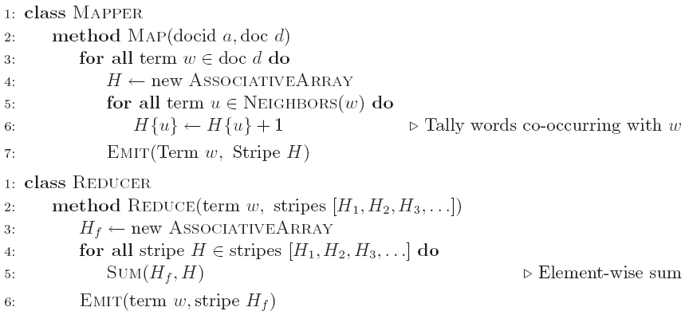
Stripes: Pseudo-Code

Slide 30
“Stripes” Analysis
Advantages
Far less sorting and shuffling of key-value pairs
Can make better use of combiners
Disadvantages
More difficult to implement
Underlying object more heavyweight
Fundamental limitation in terms of size of event space

Slide 31
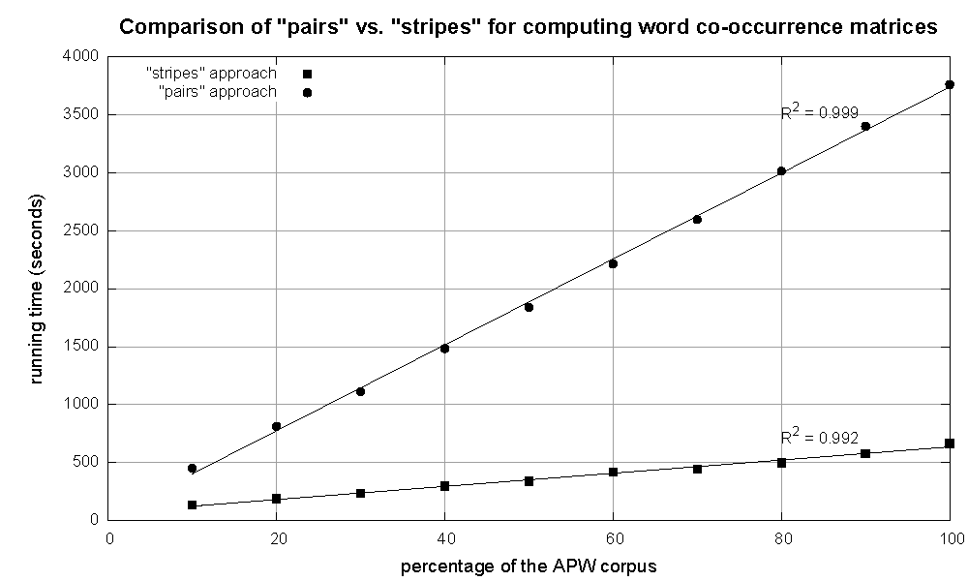
Cluster size: 38 cores
Data Source: Associated Press Worldstream (APW) of the English Gigaword Corpus (v3), which contains 2.27 million documents (1.8 GB compressed, 5.7 GB uncompressed)

Slide 32
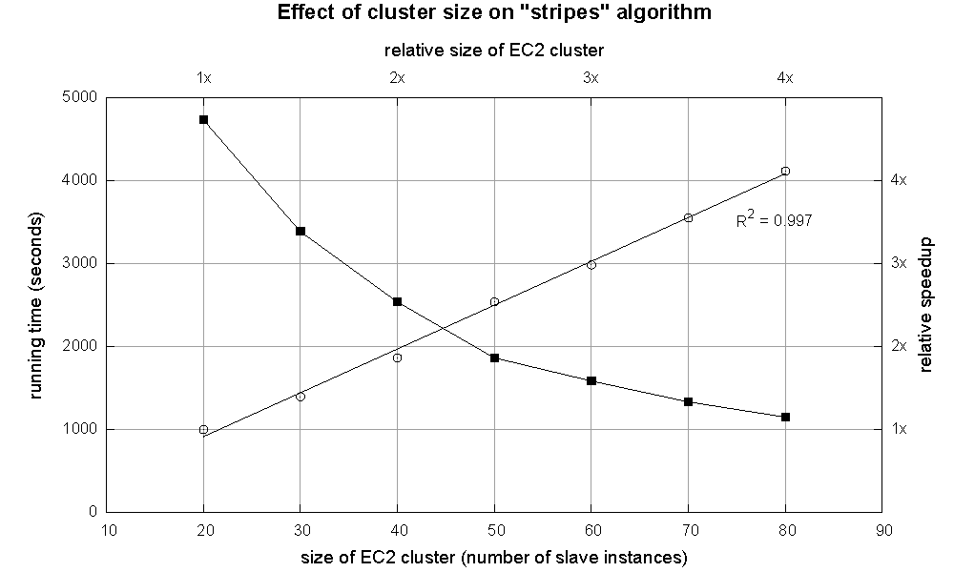

Slide 33
Relative Frequencies
How do we estimate relative frequencies from counts?
Why do we want to do this?
How do we do this with MapReduce?

Slide 34
f(B|A): “Stripes”
Easy!
One pass to compute (a, *)
Another pass to directly compute f(B|A)
a → {b₁:3, b₂ :12, b₃ :7, b₄ :1, … }

Slide 35
f(B|A): “Pairs”
What’s the issue?
Computing relative frequencies requires marginal counts
But the marginal cannot be computed until you see all counts
Buffering is a bad idea!
Solution:
What if we could get the marginal count to arrive at the reducer first?

Slide 36
f(B|A): “Pairs”
For this to work:
Must emit extra (a, *) for every b_{n} in mapper
Must make sure all a’s get sent to same reducer (use partitioner)
Must make sure (a, *) comes first (define sort order)
Must hold state in reducer across different key-value pairs
(a, *) → 32
Reducer holds this value in memory
(a, b₁) → 3
(a, b₂) → 12
(a, b₃) → 7
(a, b₄) → 1
…
(a, b₁) → 3 / 32
(a, b₂) → 12 / 32
(a, b₃) → 7 / 32
(a, b₄) → 1 / 32
…

Slide 37
“Order Inversion”
Common design pattern:
Take advantage of sorted key order at reducer to sequence computations
Get the marginal counts to arrive at the reducer before the joint counts
Optimization:
Apply in-memory combining pattern to accumulate marginal counts

Slide 38
Synchronization: Pairs vs. Stripes
Approach 1: turn synchronization into an ordering problem
Sort keys into correct order of computation
Partition key space so that each reducer gets the appropriate set of partial results
Hold state in reducer across multiple key-value pairs to perform computation
Illustrated by the “pairs” approach
Approach 2: construct data structures that bring partial results together
Each reducer receives all the data it needs to complete the computation
Illustrated by the “stripes” approach

Slide 39
Secondary Sorting
MapReduce sorts input to reducers by key
Values may be arbitrarily ordered
What if want to sort value also?
E.g., k → (v₁, r), (v₃, r), (v₄, r), (v₈, r)…

Slide 40
Secondary Sorting: Solutions
Solution 1:
Buffer values in memory, then sort
Why is this a bad idea?
Solution 2:
“Value-to-key conversion” design pattern: form composite intermediate key, (k, v₁)
Let execution framework do the sorting
Preserve state across multiple key-value pairs to handle processing
Anything else we need to do?

Slide 41
Recap: Tools for Synchronization
Cleverly-constructed data structures
Bring data together
Sort order of intermediate keys
Control order in which reducers process keys
Partitioner
Control which reducer processes which keys
Preserving state in mappers and reducers
Capture dependencies across multiple keys and values

Slide 42
Issues and Tradeoffs
Number of key-value pairs
Object creation overhead
Time for sorting and shuffling pairs across the network
Size of each key-value pair
De/serialization overhead
Local aggregation
Opportunities to perform local aggregation varies
Combiners make a big difference
Combiners vs. in-mapper combining
RAM vs. disk vs. network

Slide 43
Debugging at Scale
Works on small datasets, won’t scale… why?
Memory management issues (buffering and object creation)
Too much intermediate data
Mangled input records
Real-world data is messy!
There’s no such thing as “consistent data”
Watch out for corner cases
Isolate unexpected behavior, bring local

Slide 44
Today’s Agenda
MapReduce algorithm design
How do you express everything in terms of m, r, c, p?
Toward “design patterns”
Real-world word counting: language models
How to break all the rules and get away with it

Slide 45
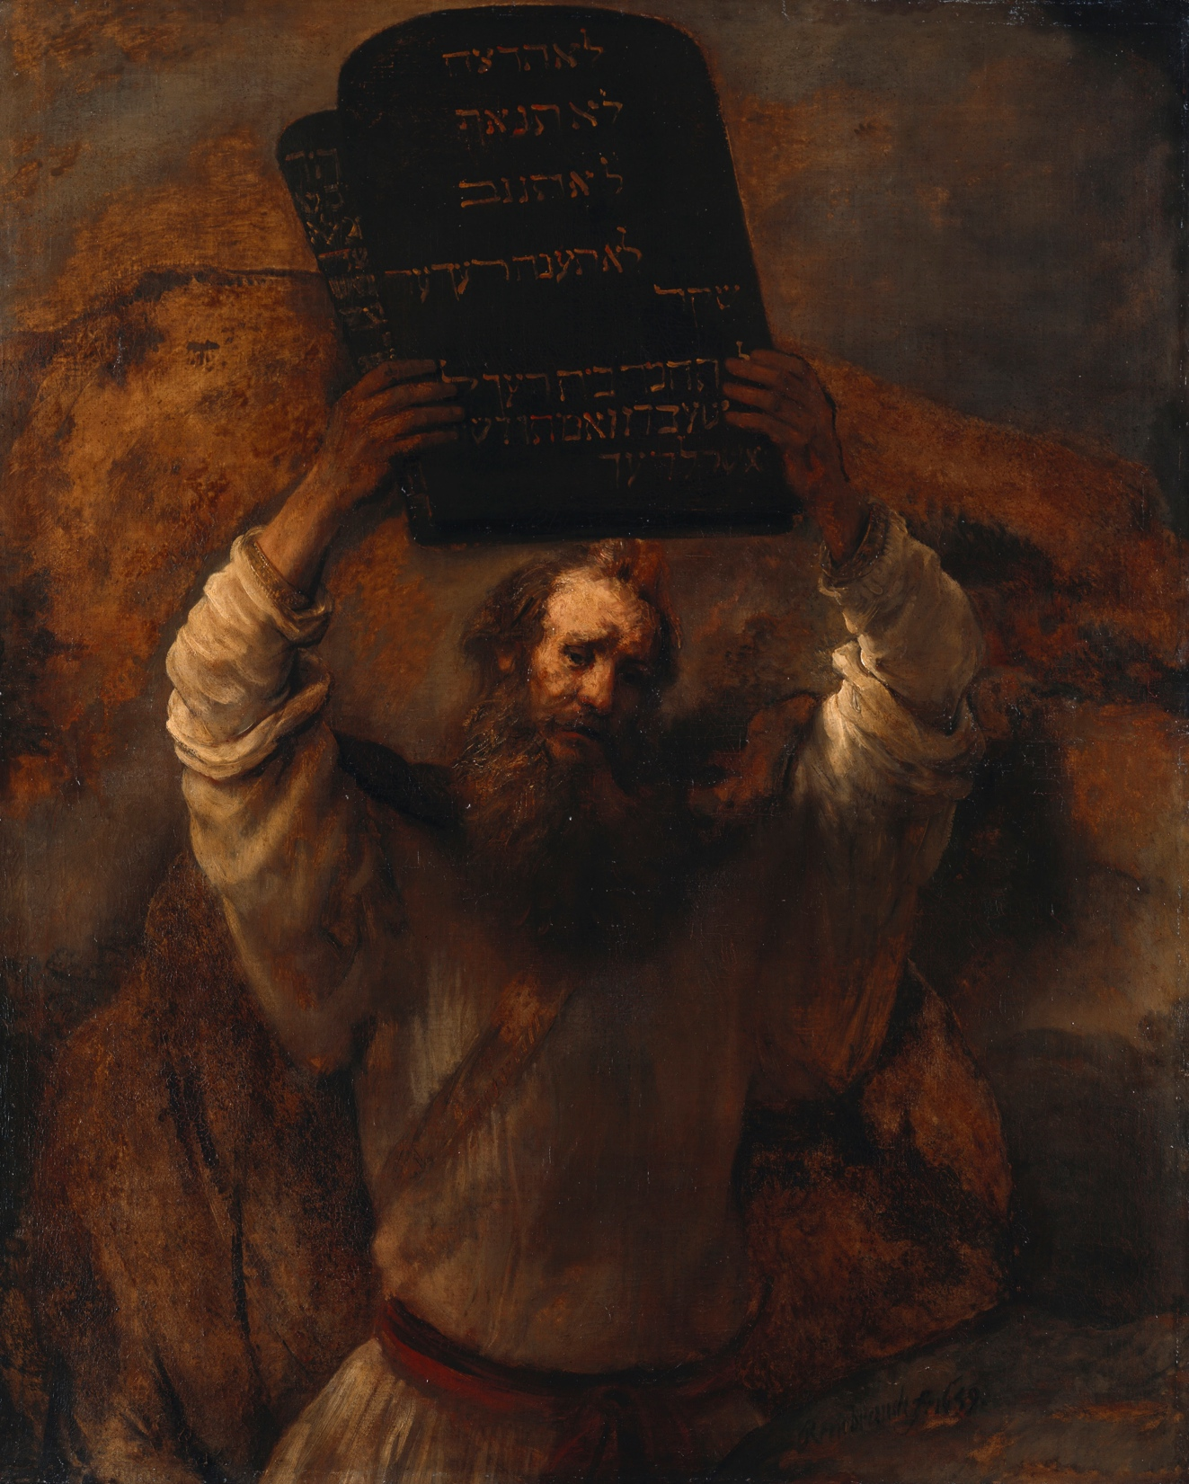
The two commandments of estimating probability distributions…
Source: Wikipedia (Moses)

Slide 46

Probabilities must sum up to one
Source: http://www.flickr.com/photos/37680518@N03/7746322384/

Slide 47

Thou shalt smooth
Source: http://www.flickr.com/photos/brettmorrison/3732910565/

Slide 48

Source: Warner Bros. Pictures

Slide 49

Count.
Normalize.
Source: http://www.flickr.com/photos/guvnah/7861418602/

Slide 50
Count.
What’s the non-toy application of word count?

Slide 51
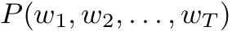
Language Models
[chain rule]
Is this tractable?
Notes:
Sentence with T words - assign a probability to it

Slide 52
Approximating Probabilities
Basic idea: limit history to fixed number of words N
(Markov Assumption)
N=1: Unigram Language Model

Slide 53
Approximating Probabilities
Basic idea: limit history to fixed number of words N
(Markov Assumption)
N=2: Bigram Language Model
Notes:
Since we also want to include the first word in the bigram model, we need a dummy beginning of sentence marker <s>. We usually also have an end of sentence marker but for the sake of brevity, I don’t show that here.

Slide 54
Approximating Probabilities
Basic idea: limit history to fixed number of words N
(Markov Assumption)
N=3: Trigram Language Model

Slide 55
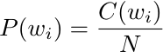
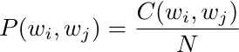
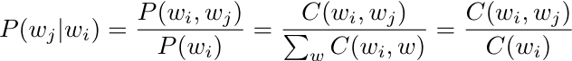
Building N-Gram Language Models
Compute maximum likelihood estimates (MLE) for individual n-gram probabilities
Unigram:
Bigram:
Generalizes to higher-order n-grams
We already know how to do this in MapReduce!
Notes:
N-gram probability estimates. Derive the conditional probability expression on board ! Given that the occurrence of an n-gram is a random variable with a binomial distribution i.e. each n-gram is independent of the next. Untrue: (a) n-grams are overlapping (b) content words tend to clump (used once, likely to get used again)

Slide 56
Thou shalt smooth!
Zeros are bad for any statistical estimator
Need better estimators because MLEs give us a lot of zeros
A distribution without zeros is “smoother”
The Robin Hood Philosophy: Take from the rich (seen n-grams) and give to the poor (unseen n-grams)
And thus also called discounting
Make sure you still have a valid probability distribution!
Lots of techniques:
Laplace, Good-Turing, Katz backoff, Jelinek-Mercer
Kneser-Ney represents best practice

Slide 57
Stupid Backoff
Let’s break all the rules:
But throw lots of data at the problem!
Source: Brants et al. (EMNLP 2007)

Slide 58
Stupid Backoff Implementation
Same basic idea as “pairs” approach discussed previously
A few optimizations:
Convert words to integers, ordered by frequency (take advantage of VByte compression)
Replicate unigram counts to all shards

Slide 59
Stupid Backoff Implementation
Straightforward approach: count each order separately
More clever approach: count all orders together
A B
A B C
A B D
A B E
…
remember this value
A B
A B C
A B C P
A B C Q
A B D
A B D X
A B D Y
…
remember this value
remember this value
remember this value

Slide 60

State of the art smoothing (less data)
vs. Count and normalize (more data)
Source: Wikipedia (Boxing)

Slide 61

Statistical Machine Translation
Source: Wikipedia (Rosetta Stone)

Slide 62
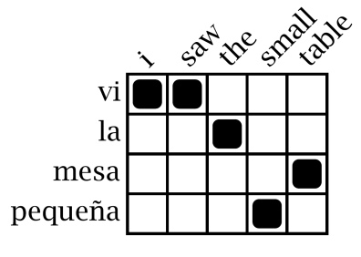
Statistical Machine Translation
Word Alignment
Phrase Extraction
Training Data
i saw the small table
(vi, i saw)
(la mesa pequeña, the small table)
…
vi la mesa pequeña
Parallel Sentences
he sat at the table
the service was good
Language Model
Translation Model
Target-Language Text
Decoder
maria no daba una bofetada a la bruja verde
mary did not slap the green witch
Foreign Input Sentence
English Output Sentence

Slide 63
Translation as a Tiling Problem
Maria
no
dio
una
bofetada
a
la
bruja
verde
Mary
Mary
not
give
a
slap
to
the
witch
green
did not
by
did not
a slap
green witch
green witch
no
slap
to the
slap
did not give
to
the
the
slap
the witch

Slide 64

English
French
channel
Source: http://www.flickr.com/photos/johnmueller/3814846567/in/pool-56226199@N00/

Slide 65
Results: Running Time
Source: Brants et al. (EMNLP 2007)

Slide 66
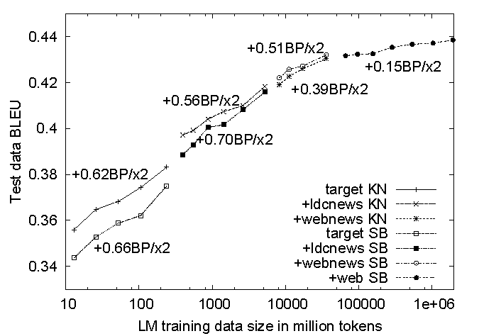
Results: Translation Quality
Source: Brants et al. (EMNLP 2007)

Slide 67
Today’s Agenda
MapReduce algorithm design
How do you express everything in terms of m, r, c, p?
Toward “design patterns”
Real-world word counting: language models
How to break all the rules and get away with it

Slide 68
Questions?
Source: Wikipedia (Japanese rock garden)

